Slide 1
A gut (microbiome) feeling about the brain
Presented by Eugene Hinderer
Brilliant title ripped from Sherwin et. al 2016
Notes:
Today I’ll be talking about how the microbial composition of our intestines can affect the brain and behavior. We’ll be looking at a paper showing that just by changing the number of a single type of bacteria, you can change the behavior of an individual. This has important implications for treatment options in human psychological conditions.

Slide 2
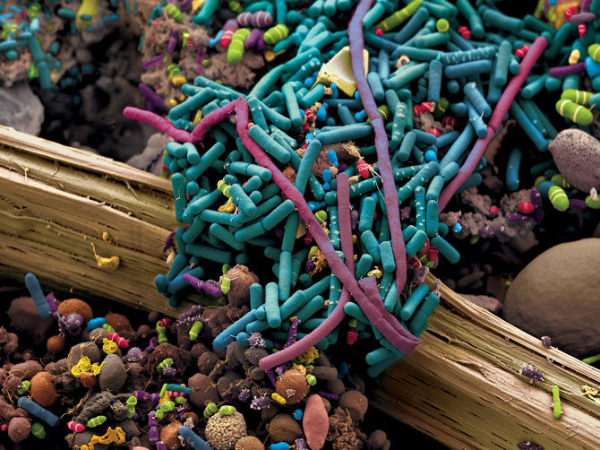
ngm.nationalgeographic.com photographed by: Martin Oeggerli
Wang et. al. 2015
Notes:
Last time, I talked about how the bacteria in our gut interacted with our own metabolism in intricate and important ways. One of these was in the production of TMAO, an important risk factor for atherosclerosis. In this pathway, choline from the food that we eat gets converted into TMA by enzymes in gut bacteria. TMA then gets converted into TMAO by our liver which then contributes to atherosclerosis. The authors aim was to develop a small molecule inhibitor (called DMB) for the bacterial TMA lyases, blocking the formation of TMAO in the pathway.

Slide 3
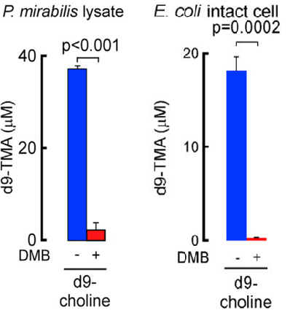
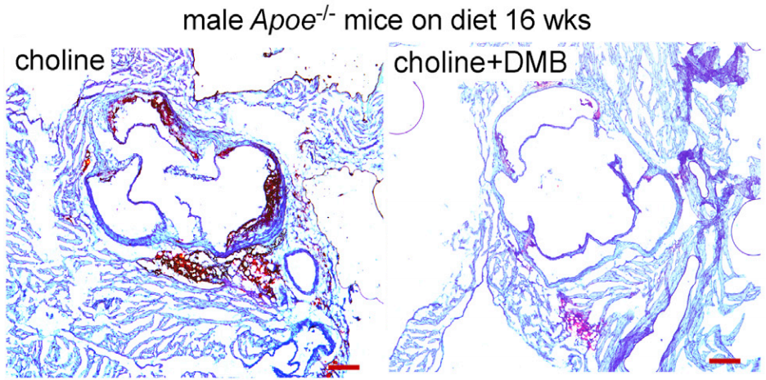
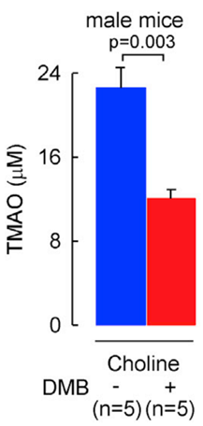
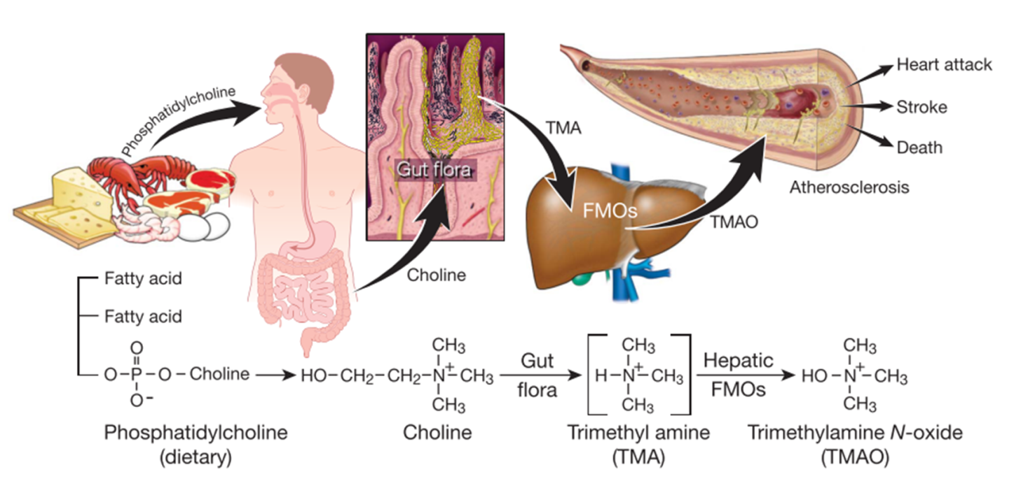
Wang et. al. 2011, 2015 (all images edited for focus)
Notes:
And they showed some convincing evidence that this strategy might be effective for treating atherosclerosis
Red: DMB greatly reduced choline-derived TMA production in isolated bacteria
Green: mice on choline diets with DMB in their drinking water showed significant reductions in systemic TMAO
Red: and this reduction in TMAO correlated with an attenuation of atherosclerotic phenotypes (here you can see a reduction in aortic plaque size)

Slide 4
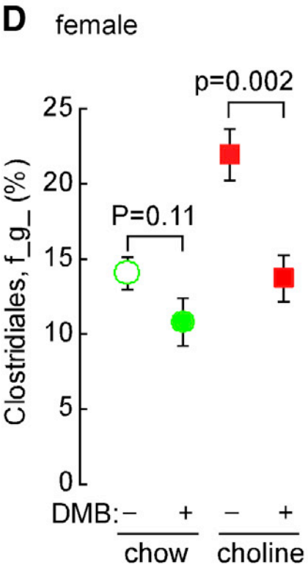
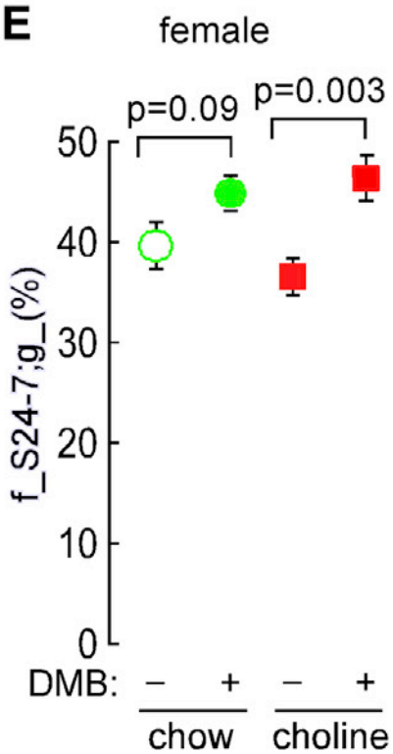
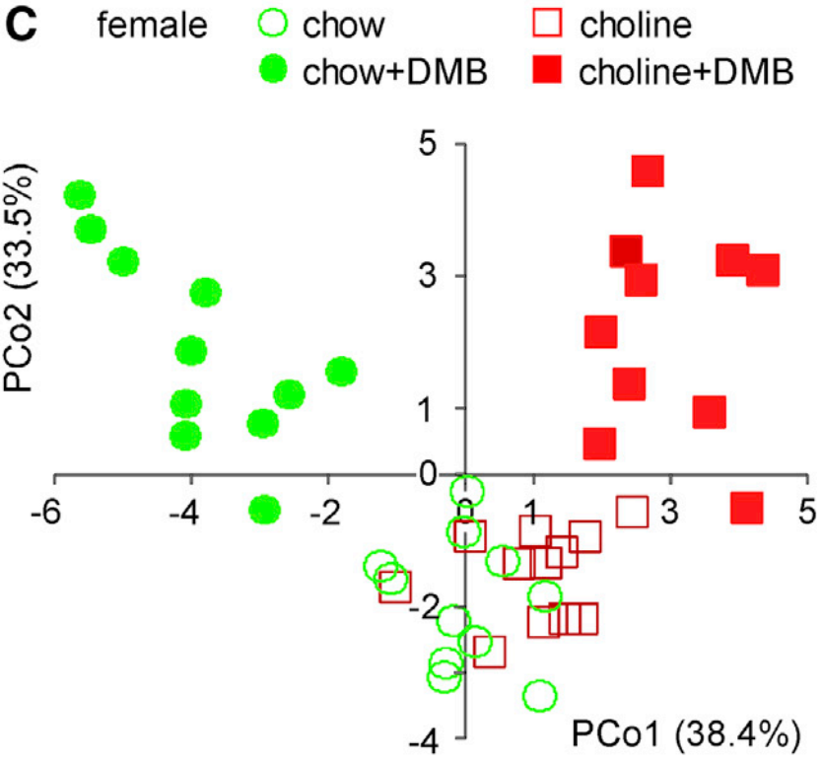
DMB alters microflora composition
Wang et. al. 2015
Notes:
But what I left off with last time is kind of where I’ll pick up today: the authors showed that the bacterial composition shifted in mice with different diets AND also shifted in response to DMB treatment. This is a principle component analysis where each point represents the gut microbiome composition of a single mouse points cluster by diet and treatment type, meaning that those are similar to each other. Furthermore they could show increases or decreases in the proportions of specific species and correlate them with the phenotypes of the mice. Last time I raised the question of whether the effects seen in this study came directly from the inhibitors effect on the microbial enzymes, or whether DMB’s main effect came from the fact that it elicited a selective pressure on the microbial ecosystem that favored one species to grow over another. In other words perhaps the shift in TMA production came from the fact that there was a shift in the microbiome composition

Slide 5
Can we manipulate microbiome composition to treat complex host-commensal pathologies?
Notes:
So now we are poised to ask, can we manipulate the microbiome composition to treat these complex host-commensal pathologies? This strategy would not require identifying specific drug targets in bacteria and testing multiple chemical derivatives for effectiveness, like I talked about in my last talk. Rather, in this strategy, you could get away with using the much cheaper pro-biotics and/or pre-biotic. Plus using this approach, you would reduce risks associated with off-target effects of small molecule drugs.

Slide 6
Notes:
As it turns out, investigators are already exploring this in some very fascinating example cases. Today I’ll be moving away from atherosclerosis and focusing on another way commensal bacteria play a role in host biology: the effect they have on brain chemistry and behavior. As you can read from the title, they used prebiotics to affect microbial composition in mice in such a way as to reduce anxious behavior. Now, I didn’t choose to present this article because it was flawless or that it had unshakable, conclusive results. But I chose it because it is among the first to show that directly targeting commensal bacteria can affect behavior and brain chemistry.
This offers some initial evidence that it might be possible to treat psychological conditions like depression and anxiety by targeting commensal bacteria.

Slide 7
Anxiety and depression are major problems in America
21% of children 13-18 experiences a severe mental disorder at some point in their life¹
18% of adults suffer some form of anxiety disorder²
Mood disorders including major depression are the 3rd most common cause of hospitalization³
Suicide is the 10th leading cause of death in the US, 3rd for people aged 10-24⁴
http://www.nimh.nih.gov/health/statistics/prevalence/any-disorder-among-children.shtml
http://www.nimh.nih.gov/health/statistics/prevalence/any-anxiety-disorder-among-adults.shtml
http://www.hcup-us.ahrq.gov/reports/factsandfigures/2009/pdfs/FF_report_2009.pdf
http://www.suicidology.org/Portals/14/docs/Resources/FactSheets/2013datapgsv2alt.pdf
Data compiled from https://www.nami.org/Learn-More/Mental-Health-By-the-Numbers
Notes:
What’s more, prescription medication, while effective alongside therapy for many sufferers has many risks associated with it. Side effects include dramatic exacerbation of the worst symptoms of the disorders that they are designed to treat. These include suicidal thoughts, irritability, and increased anxiety. This is especially true for children and young adults. For this reason, it is especially attractive for new treatments to be developed for mood disorders.

Slide 8
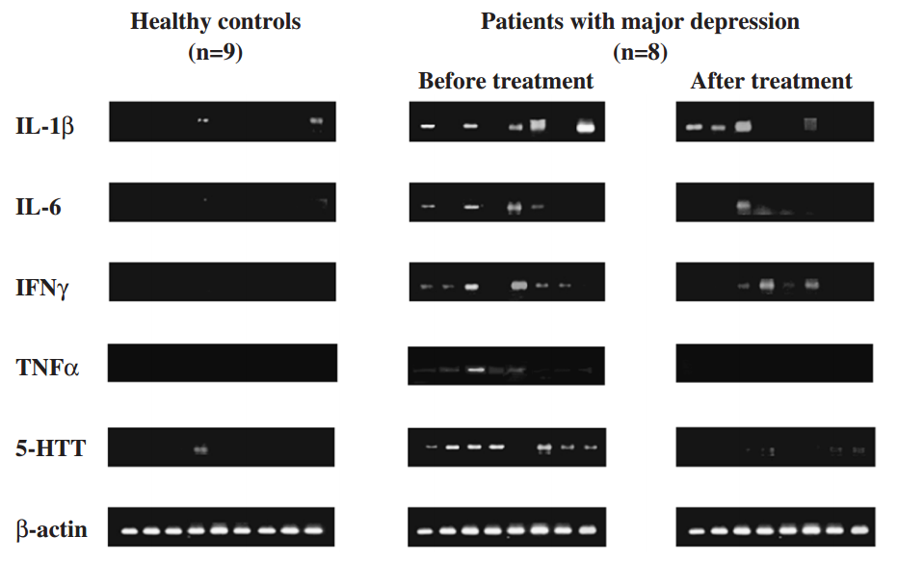
Inflammatory cytokines correlate with depression and anxiety
Tsao et. al. 2006
Notes:
Obviously, the main causes for anxiety, depression, and other psychological disorders stem from a highly complex set of environmental and genetic factors coupled with the personal experiences of an individual. There’s not one cause for these disorders and there will likely never be a single treatment solution, but new investigations into the brain chemistry of psychiatric patients have opened up some avenues that haven’t been fully explored. One such avenue is the correlation between inflammation and mood disorders.
Serotonin or 5-HT is an important neurotransmitter for regulating smooth muscle tone, nerve impulses and also contributes for well being and happiness. Through mechanisms that I can’t go into today, an increase in the number of 5-HT receptors have been consistently found in the brains of depressed people post-mortem, especially in the brains of people who committed suicide.
Many studies point out the fact that cytokine inflammatory signaling often occurs alongside this phenomenon. These cytokines include IL1-b, IL6, INFgamma, TNFalpha, and IL10 (note shown here).

Slide 9
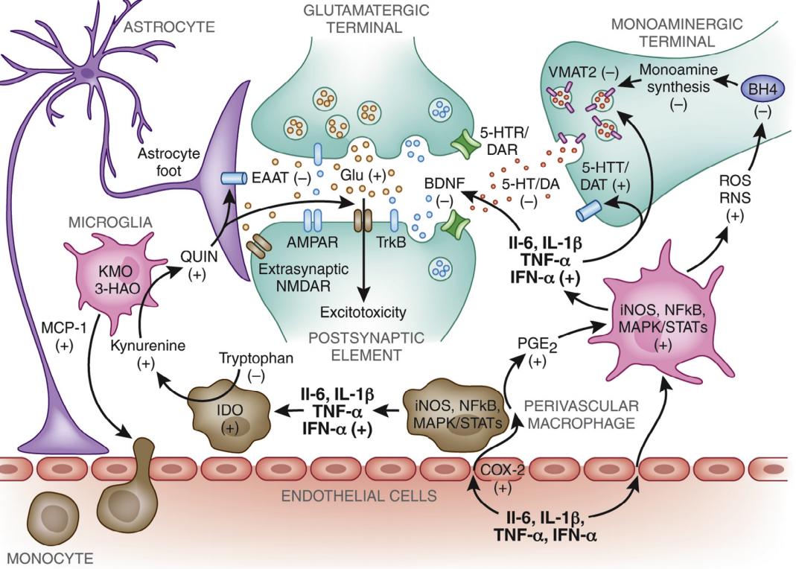
Inflammatory cytokines correlate with depression and anxiety
Felger and Lotrich, 2013
Notes:
I will happily spare you the excruciating details, but for anyone interested, this review from Felger and Lotrich covers inflammation and depression and points out therapeutic potential.

Slide 10
Gut microbes influence CNS signaling
Cryan and Dinan 2012
Notes:
Okay, back to the bacteria. It is now generally accepted that a stable gut microbiota is essential for normal gut physiology and contributes to appropriate signaling along the gut–brain axis and, thereby, to the healthy status of the individual. As shown on the right-hand side of the figure, intestinal dysbiosis can adversely influence gut physiology, leading to inappropriate gut–brain axis signaling and associated consequences for CNS functions and resulting in disease states. Conversely, stress at the level of the CNS can affect gut function and lead to disturbances of the microbiome.

Slide 11
Multiple mechanisms implicated along gut-brain-axis
Endocrine: bidirectional influence along HPA axis
Chronic stress alters microflora composition
Microflora affect HPA axis
Neural: bacteria-derived neuroactive molecules
Enter circulation
Act on vagus nerve
Immune: bacteria activate inflammatory response
Immune cell activation, including microglia
Release of cytokines (IL-1, IL-6, IL-10, TNFα)
Increased serotonergic receptor density (5-HTR)
Cryan and Dinan 2012
Notes:
Many mechanisms have been proposed to explain how gut bacteria illicit effects on the brain. It has been long known that chronic stress alters the bacterial composition of the gut. And recent studies have been examining how the altered gut composition might in tern affect behavior. Part of this has to do with the fact that the stress response can irritate the walls of the intestines leading to a “leaky gut.” Even without this “leaky gut” phenomenon, there is an exchange of material between the gut bacteria and the host, including the release of bacteria-derived molecules that can be neuroactive. These molecules can access the circulation to reach the brain through the BBB, or can act on the Vagus nerve that innervates the intestines. Most importantly, though this exposure activates the hosts’ immune response, as I alluded to earlier. Unsurprisingly, this is the pathway of focus for the authors.

Slide 12
Ways to alter the microbiome
Antibiotics – bad
Removes beneficial species
Creates resistance
Targeted inhibitors
Probiotics
Prebiotics

Slide 13
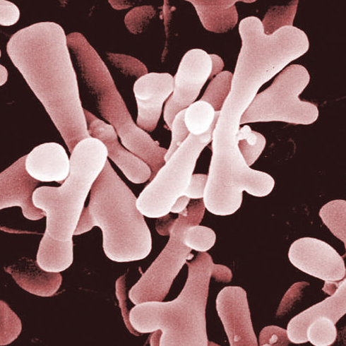
Specific bacteria confer antidepressant/anxiolytic properties
https://microbewiki.kenyon.edu/index.php/The_role_of_Bifidobacterium_on_the_Immune_System
Notes:
Previous studies conducted by the authors showed that strains of Bifidobacteria and Lactobacilli had anxiolytic and anti-depressive effects in rodents, and other research confirmed this effect in humans. Other bacteria such as lactobacilli also display similar properties but were not the focus of this investigation.

Slide 14
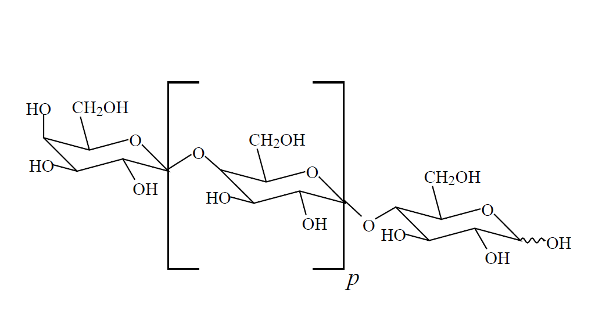
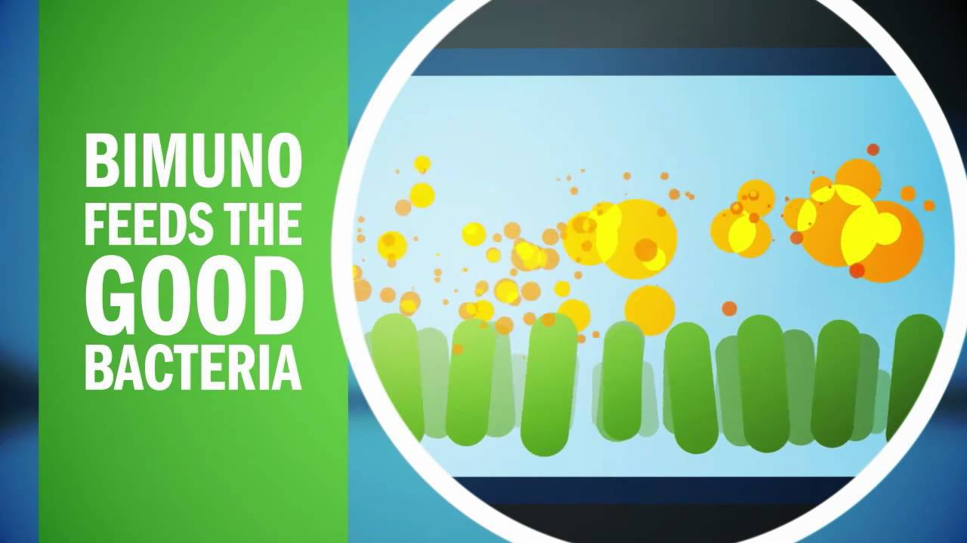
Bimuno® Galacto-Oligosaccharides (BGOS)
Notes:
Bimuno® galacto-oligosaccharide (BGOS) is a commercially available prebiotic made of beta-galactose. Prebiotics are indigestible to the host but may be utilized by gut bacteria. While prebiotics are specific, they can promote the growth of many species of bacteria in the same Genus. This specific prebiotic has been shown to increase the composition of Bifidobacteria (containing over 30 species) it has also been shown to increase the populations other beneficial bacteria like lactobacilli.
So…
Lets get some mice scared and sad and see if prebiotics make them less scared and-or sad!

Slide 15
How do we make mice sad/scared?
Mice exhibit “sickness behavior” when infected
Decreased motor function several hours after injection
Depression
Increased anxiety
Induce with antigens like lipopolysaccharide (LPS)
Notes:
We can make mice sad and anxious by taking advantage of the “sickness behavior” that they demonstrate when they are infected. This includes decreased motor function for several hours after infection, which fully diminishes after the first 24 hours. Afterwards however, mice are still known to exhibit depressive and anxious behavior without motor impairment. Infecting mice with live bacteria or other pathogens might interfere with the commensal bacteria that are the focus of this study. Luckily the authors could accomplish the same effects with lipopolysaccharide (LPS), which is a cell wall component antigen from gram-negative bacteria.

Slide 16
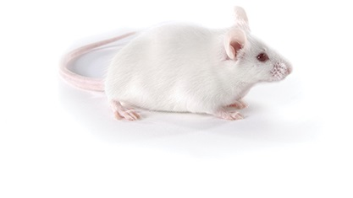
Experimental design
/
/
/
Male CD1 mice:
Consistency with previous studies
Exaggerated pro-inflammatory cytokine response
Savignac et al 2015
Notes:
So here is the outline of the experimental design. Male CD1 mice were used to maintain consistency with previous studies and also because these mice display increased pro-inflammatory cytokine response. 7-8 week old naturally born mice were fed pure water or water with BGOS for 3 weeks and then infected peripherally with LPS to induce sickness behavior. Three behavioral tests were then performed (which I will explain as I present the results). The locomotor activity test measured LPS and BGOS’s effects on depressive behavior, the marble burying test also tested depressive as well as anxious behavior and the Light dark box tested anxious behavior. After the second day of testing mice were sacrificed and had cytokine and serotonin receptor concentrations quantified from frontal cortex tissue.

Slide 17
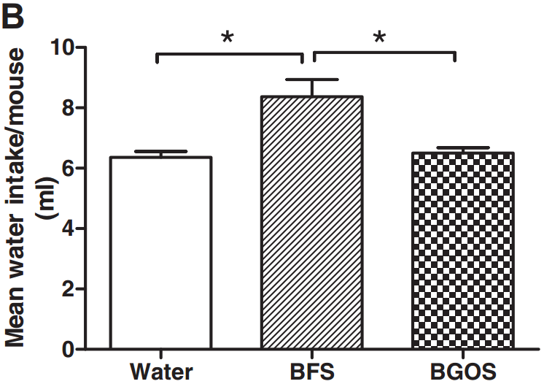
BGSO elevates Bifidobacteria in mouse intestines
Savignac et al 2015
Notes:
A pilot study was first conducted to determine appropriate controls and to ensure that the BGSO increased Bidifobacteria sufficiently. Previous studies involved administering BGSO through gastric gavage, to reduce the stress associated with that procedure, the authors studied the effects via drinking water. As a potential control, they used a solution containing only the free sugars contained in the BGSO solution (lactose, glucose, galactose) which is labeled BGFO Free Sugars (BFS). As expected, the BGOS resulted in a significant increase in colony forming units of Bifidobacteria in mouse feces. However, the mice really liked drinking the sugar water. Because the mean water intake was significantly higher in BFS than BGOS, and the intake of water and BGOS was similar water was used as the control in the study.

Slide 18
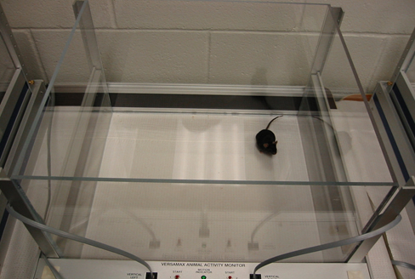
https://www.cidd.unc.edu/images/mouseOpenField.jpg
Notes:
In this test, the behavior of mice is measured by how much they move to explore their environment. Sensors are placed around the box to track how much they’ve moved over time. In general, a more exploratory mouse can be imagined to be less effected by sickness behavior, and one that moves less is still exhibiting symptoms of sickness behavior. This can be plotted as the number of sensor beam-breaks over time. Mice were in here for 2 hours.

Slide 19
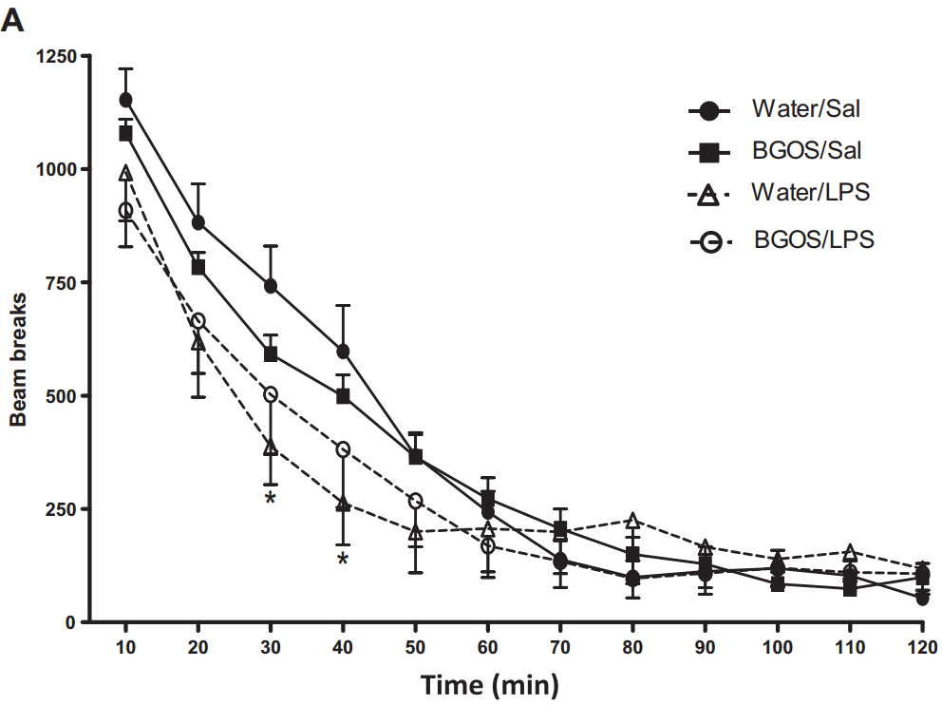
LPS influences locomotor activity but BGSO showed no significant influence
Savignac et al 2015
Notes:
The results are not very exciting for this initial test. Although we can see a main effect of LPS causing decreased movement in mice, (indicating locomotor impairment and a depressed-like state), BGOS treatment does not significantly affect this behavior. This is the way I look at it. Healthy mice are eager to explore new territory before getting bored, but the sick mice are more sad and don’t walk around as much before getting bored.

Slide 20
https://spectrumnews.org/wp-content/uploads/image-archive/images/conference-reports/sfn2012-oxotremorine.jpg
Notes:
In the second test behavior was measured by evaluating how many marbles the mice buried marbles in soft bedding within a 30 minute period. Results were be plotted as the square root of how many of the 20 marbles each mouse buried. This test is useful for testing neophobia, anxiety, and obsessive compulsive behaviors. Rodents will dig into the ground in font of new or potentially threatening things. Burying is thought to be a sign of anxious behavior.

Slide 21
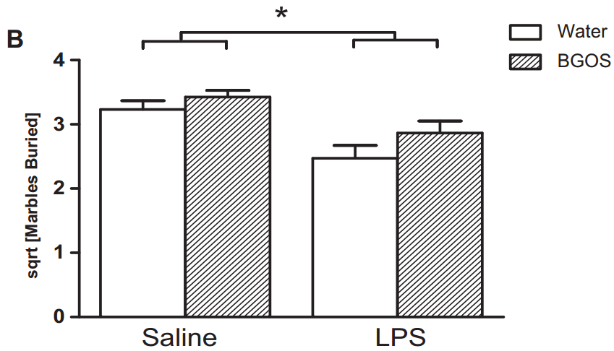
LPS influences burying behavior but BGSO showed no significant influence
Savignac et al 2015
Notes:
Again, the results did not indicate that BGOS had a significant effect. Interestingly, LPS injection had a significant effect and appeared to reduce this anxious behavior. However, the reduced digging activity may be more a result of a depressed state from sickness and less a result of reduced anxiety.

Slide 22
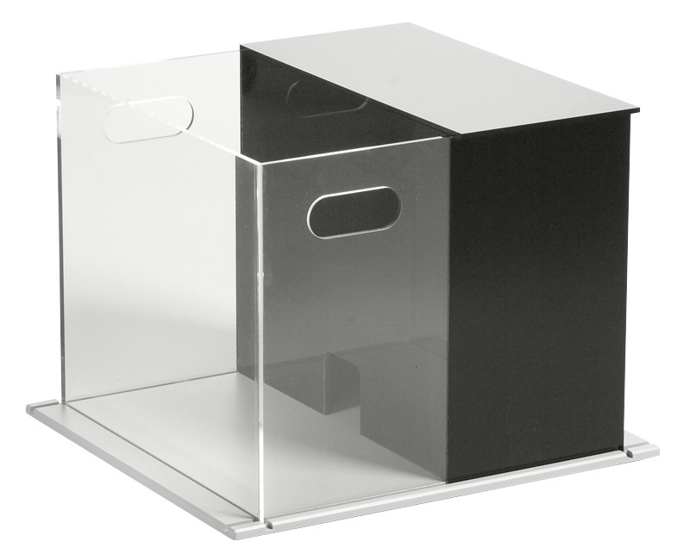
http://www.stoeltingco.com/media/catalog/product/cache/1/image/9df78eab33525d08d6e5fb8d27136e95/6/3/63101-sto_ab_nc_black_clear-l_web_1.jpg
Notes:
Oh man, thigs aren’t looking good for this… Well remember that locomotor function is impaired in mice following LPS injection for several hours after. By 24 hours, all locomotor functionality is restored but there is a retained depressed/anxious state. So 24 hours after injection, the authors reevaluated anxious behavior by putting the mice through the Light-Dark box. This is another classic test for anxiety. It factors a mouse’s curiosity driven drive to explore open spaces with its fear of bright places (mice are nocturnal and tend to avoid light, where predators might see them). A box is partitioned into 2 sections, on dark and opaque, and one with clear walls that is brighter. There is a little doorway between the sections. The mice were placed into the dark section and allowed to explore freely for 5 minutes.

Slide 23
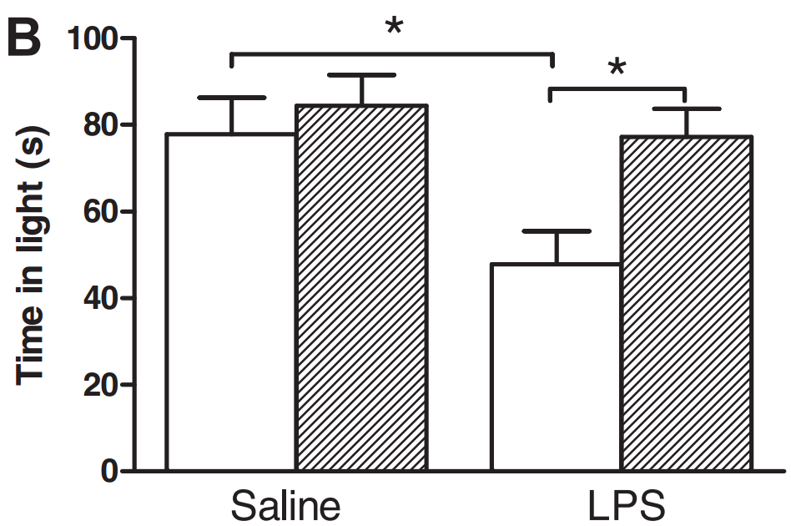
BGOS attenuates LPS-induced anxiety in LD-box tests
Savignac et al 2015
Notes:
LPS treated mice showed increased hesitation to leave the safe dark room and explore the new environment. BGOS treatment abolished that behavior. Mice with (supposedly) increased Bifidobacteria exhibited normal behavior despite being infected with LPS. In the same way, mice with LPS spent less time in the light, but the BGOS prebiotic treatment also attenuated the effect. So overall mice with the prebiotic showed reduced anxiety in the face of LPS infection.

Slide 24
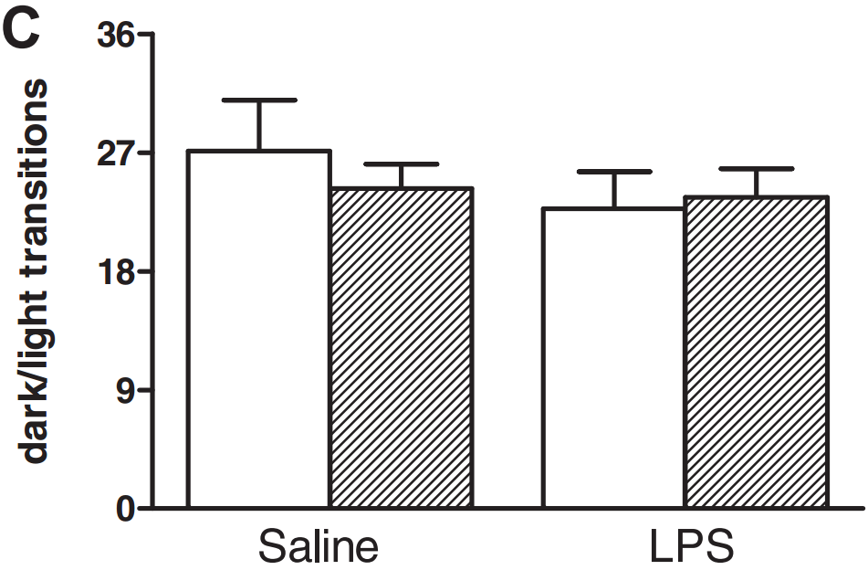
BGOS attenuates LPS-induced anxiety in LD-box tests
Savignac et al 2015
Notes:
Importantly, the overall movement of the mice do not appear to be affected, as the number of room transitions remained similar across all groups. Therefore it does not seem that at this time point locomotor impairment was a factor in the results.

Slide 25
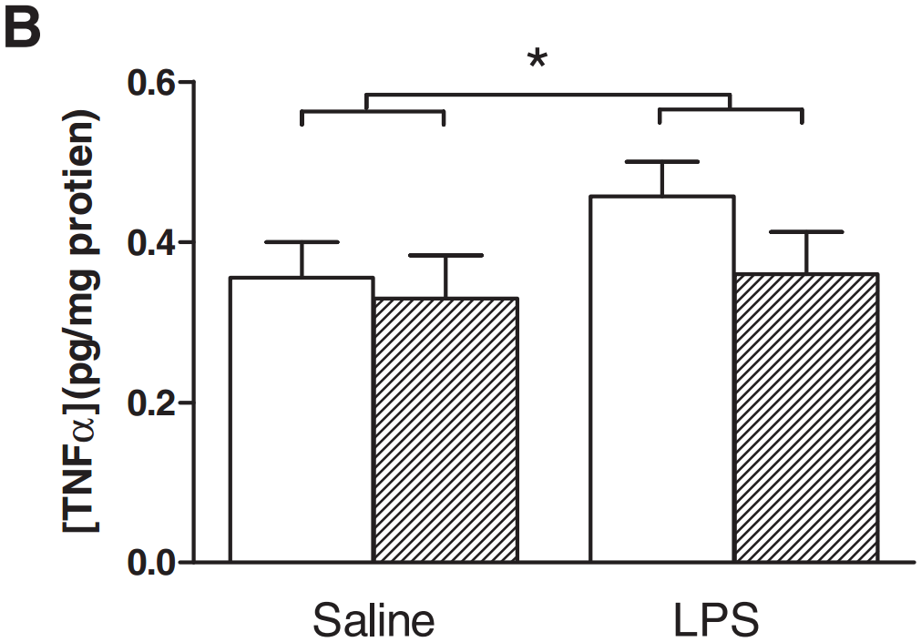
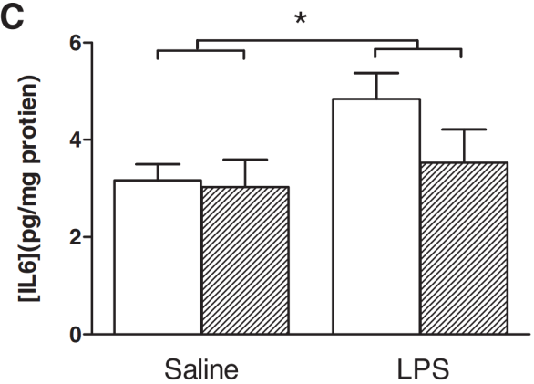
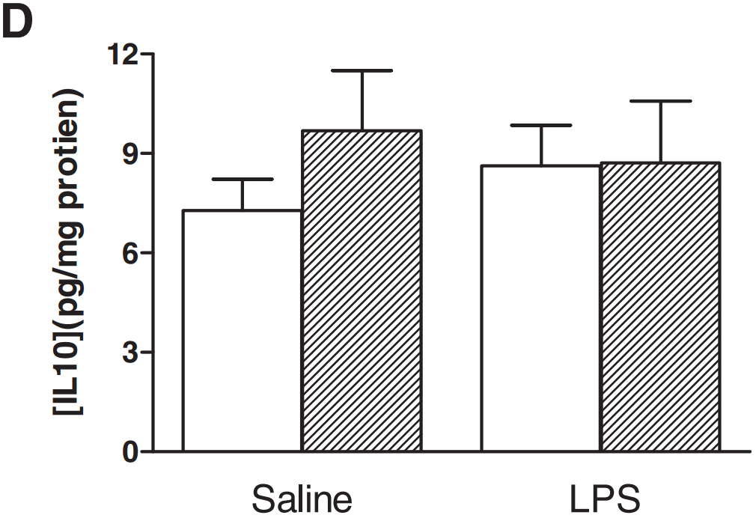
What could be the mechanism for these changes in behavior?
IL-1β
Savignac et al 2015
Notes:
Remember, increased concentrations of specific cytokines are indicative inflammation that correlates with depression and anxiety in both rodents and in humans. The authors investigated the possible mechanisms behind the observed alterations in behavior by looking at these cytokines of interest from the mouse frontal cortex tissue. The concentrations of these cytokines were measured from frontal cortex tissue using commercial ELISA kits. Results show that only IL1-B showed both significant increases following LPS treatment AND subsequent attenuation in mice treated with the prebiotic.

Slide 26
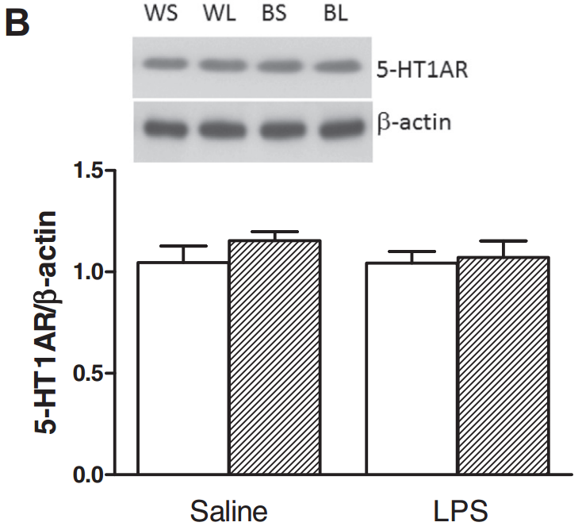
BGOS attenuates LPS-induced over-expression of 5-HT2a receptor
Savignac et al 2015
5-HT2aR
5-HT1aR
Notes:
Remember also that an increased expression of some serotonergic 5-HT receptors are a strongly linked to depression and anxiety. In fact some anti-anxiety medications target these receptors. Here the authors show that there is a small but statistically significant increase in the number of expressed 5-HT2a receptors in mouse frontal cortexes. Critically, we can also see that BGOS treatment resulted in a lower expression of these receptors, mimicking the expression of non-injected mice. This is consistent with the normal-behavior phenotype. The same effect was not seen in another serotonergic receptor, 5-HT1aR . This suggests that LPS induced sickness behavior is acting on specific serotonergic receptors, presumably through the effects of IL-1b.

Slide 27
Conclusions
With the exception of marble burying behavior, BGOS treatment attenuated the anxiety of mice with LPS-induced sickness behavior
This behavior coincided with the expression of inflammatory cytokines and serotonergic receptors
There is an apparent link between IL-1b, 5-HT2aR, and anxious behavior in mice following infection

Slide 28
Conclusions
Prebiotic administration alone is sufficient for affecting behavior in animal models
Notes:
But the important conclusion is that…. While the potential strategy for treating psychiatric disorders with prebiotics is still a very far off possibility, results like this are encouraging for further investigation.

Slide 29
Caveats, limitations, weaknesses
Investigation focused on infection-induced sickness behavior
Two of the three mouse tests failed to produce conclusive or favorable results
The microbiomes were not characterized at the end of the experiment!
Notes:
1) The results demonstrated here were essentially treating anxiety from LPS-induced sickness behavior
Other mechanisms (either endogenous or from bacteria) may be more prominent in human applications like the treatment of generalized anxiety
2) The most obvious weakness is that most of the mouse tests were inconclusive or did not produce results supportive of the hypothesis. While it is true that the marble burying test could have been affected by remnant locomotor impairment, it begs the question, why didn’t the authors wait to conduct the test until the second day?
3) We are to assume based on the pilot study and based off of previous reports that the effects of BGOS seen on mouse behavior and in the immune response was a result of an increase in the population of bifidobacteria in the gut. How simple would it have been to confirm bifidobacteria increased with BGSO treatment and that it corresponded to changes in mood? What would have been even better would be if they could have characterized the populations of other bacteria to see how they changed in response to stress and in response to BGOS. As it stands, the association between bifidobacteria and anxiolytic effects is only assumed. Maybe there are other as-of-now correlated bacteria that are affected by BGOS or maybe other bacterial shifts occur alongside changes in mood that might also be implicated in anxiolytic activity.

Slide 30
Future directions
How do bifidobacteria attenuate IL-1b expression?
What is the mechanism correlating IL-1b and serotonergic receptors
What mediates the specificity of IL-1b and the receptor subtype?
Are there other bacteria that play a role in this anxiolytic activity?
Host-commensal interaction databases?

Slide 31
“Drugging repopulating the microbiome”
Potential avenue for therapeutics blocked by lack of knowledge about intricate host-microbe interactions
Highlights the utility of bioinformatic and systems biology tools
Prebiotic treatment for increasing anxiolytic bacterial populations represents another proof-of-concept in microbiome therapeutics

Slide 32
Thank you!

